Slide 1
Stock Pitch Competition Name
The Aggie Investment Club
Rating/Suggestion (Long/Short/Buy/Outperform, etc.)
Company Name
Ticker
Name
Contact Info
Name
Contact Info
Name
Contact Info
Name
Contact Info

Slide 2
Investment Thesis
Current Price: xxx
Price Target: xxx
Implied Upside: xxx
Company XYZ presents a compelling investment opportunity lead by:
Reason #1
Reason #2
Why do you believe the company is overvalued/undervalued, and why?
Why is the market mispricing the opportunity?
Insert Sources Here

Slide 3
Industry/Market/Sector Overview
You can include, but are not limited to:
What is the market size?
What is the growth rate of the industry?
Why is the industry growing/not growing?
What factors affect the industry? (Consumer spending, housing market, consumer confidence, interest rates, etc.)
How does the market react to adverse market conditions? (What will the market do in a recessionary environment)?
Charts and graphs can be helpful here.
IBIS World, CapIQ
Insert Sources Here

Slide 4
Competitive Landscape
You can include, but are not limited to:
Who are the main competitors of your target company?
What market share does each company have?
What is the size of each company?
What geographics do the companies operate in?
What products/services do competitors sell, and how do they differ from your target company?
Brand recognition of each company?
IBIS World, Orbis, CapIQ
Insert Sources Here

Slide 5
Company Overview
You can include, but are not limited to:
What does the company actually do?
What do they sell/what services do they provide?
Revenue segments?
What does the history of the company look like?
When were they founded?
When did they IPO?
Have they participated in any M&A activity recently?
What does their stock chart look like over the past 5 years? (Include context on big market moves)
What strategic initiatives is the business currently pursuing?
Insert Sources Here

Slide 6
Management Team
You can include, but are not limited to:
Who is on the management team?
CEO
CFO
COO
Anyone else you think is relevant to the business
Who is on the board of directors?
Include a short bio of each management team member you include
Are there any key takeaways that we should care about in regards to the management team?
Is it mostly a new management team?
Are they a young management team?
Have they done impressive/poor things at previous companies?
Do they have a good capital allocation history?
Good/Bad M&A Record?
Insert Sources Here

Slide 7
Competitive Advantage
You can include, but are not limited to:
If the company has a competitive advantage, what is it?
Unique and differentiated business model
Intellectual property
Strong brand recognition
Superior technology
Supplier/Consumer partnerships and relationships (Exclusive access to suppliers and customers)
Is it actually a sustainable advantage, and how will they keep it?
Has the competitive advantage led them to sustain high returns on invested capital in the past? Will it in the future?
Insert Sources Here

Slide 8
Catalysts
You can include, but are not limited to:
What event is going to cause the stock to move in the direction that matches your thesis? (up/down)
Short-term, mid-term, and long-term catalysts:
M&A activity
Corporate restructuring
Spinoff
Legislative changes
Lawsuit
Earnings reports
Earnings guidance revisions
New product launch
Management change
Macro catalysts: Interest rate changes, inflationary pressures, consumer spending, energy prices?
Insert Sources Here

Slide 9
Valuation
This will likely involve multiple slides. You can include, but are not limited to:
Discounted cash flow model
Comparable analysis model
Precedent transactions model
Football field chart
This is a chart that shows the implied share price of all the different models
You can use all 3 models (bull, base, and bear case), analyst estimates, multiple comp methods (EV/EBITDA, P/E, etc.)
Do NOT put all of your million different models in the deck… use the appendix!
Insert Sources Here

Slide 10
Asymmetric Risk/Reward
You can include, but are not limited to:
Is there a positive asymmetric risk/reward?
Does the reward outweigh the risk?
What is the bull case?
What is the bear case?
Don’t be afraid to have negative returns for you bear case
Insert Sources Here

Slide 11
Risks & Mitigation
You can include, but are not limited to:
What are the risks involved with the investment?
Macro factors: int rates, consumer spending, energy prices, consumer confidence, housing market, etc.
Regulatory and legal risk
High debt burden
Share dilution
Supplier/customer risk (Are a high % of sales/inventory coming from only a few stakeholders)
Geopolitical risk
Do not sugarcoat it and pretend there are no risks
How can these risks be mitigated?
Not all risks can be mitigated quickly, if at all
Insert Sources Here

Slide 12
Final Recommendation
Summarize all of your key points
Your entire pitch should be telling a story, and this should be the sparknotes!
Why is this a compelling investment?
Re-state the implied share price and implied upside
Based on a current share price of xxx, we see a xxx upside with an implied share price of xxx.
Insert Sources Here

Slide 13
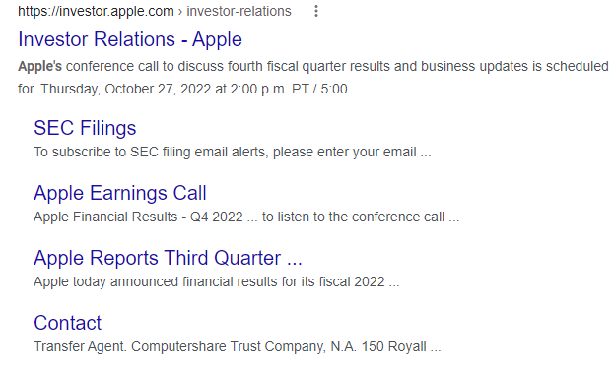
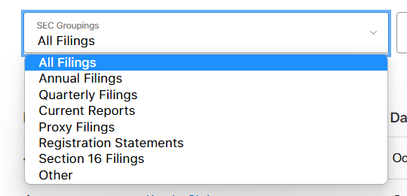
How to find 10K/10Q (NOT PART OF TEMPLATE)
10-K
10-Q

Slide 14
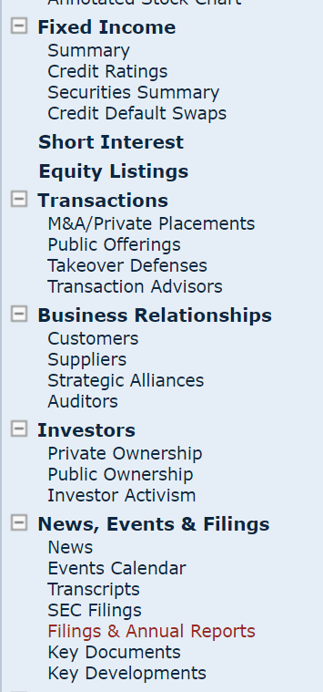
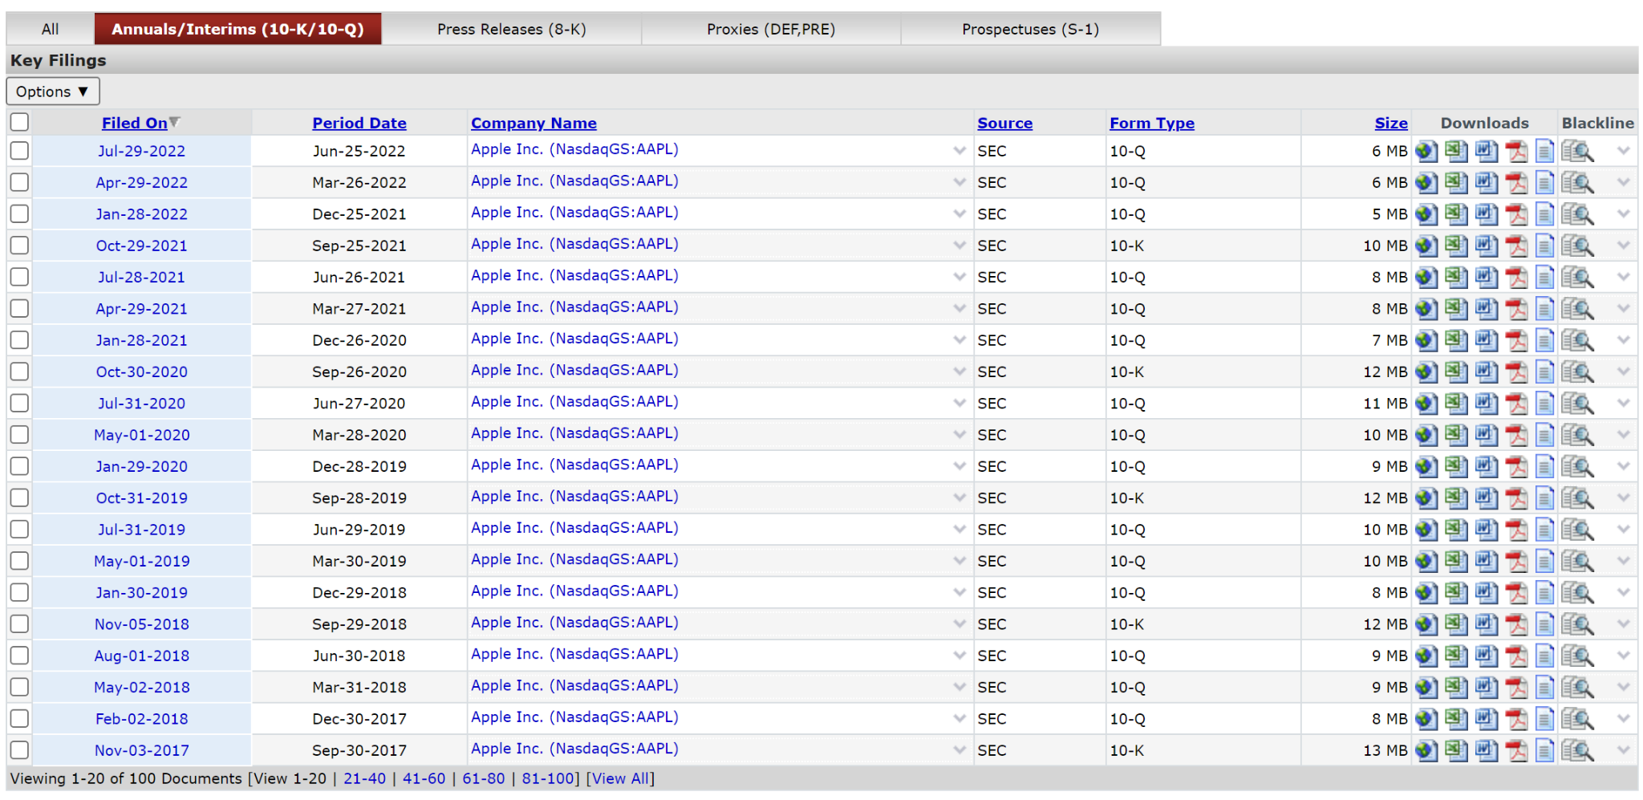
How to find 10K/10Q (NOT PART OF TEMPLATE)
Cap IQ

Slide 15
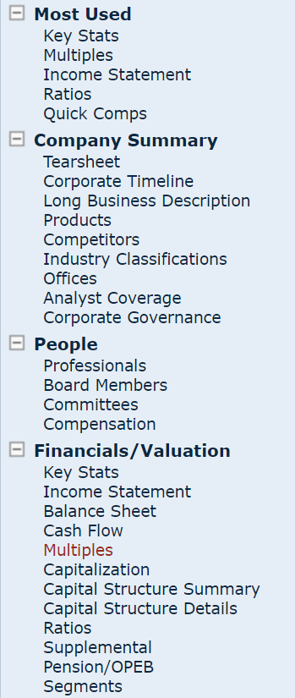
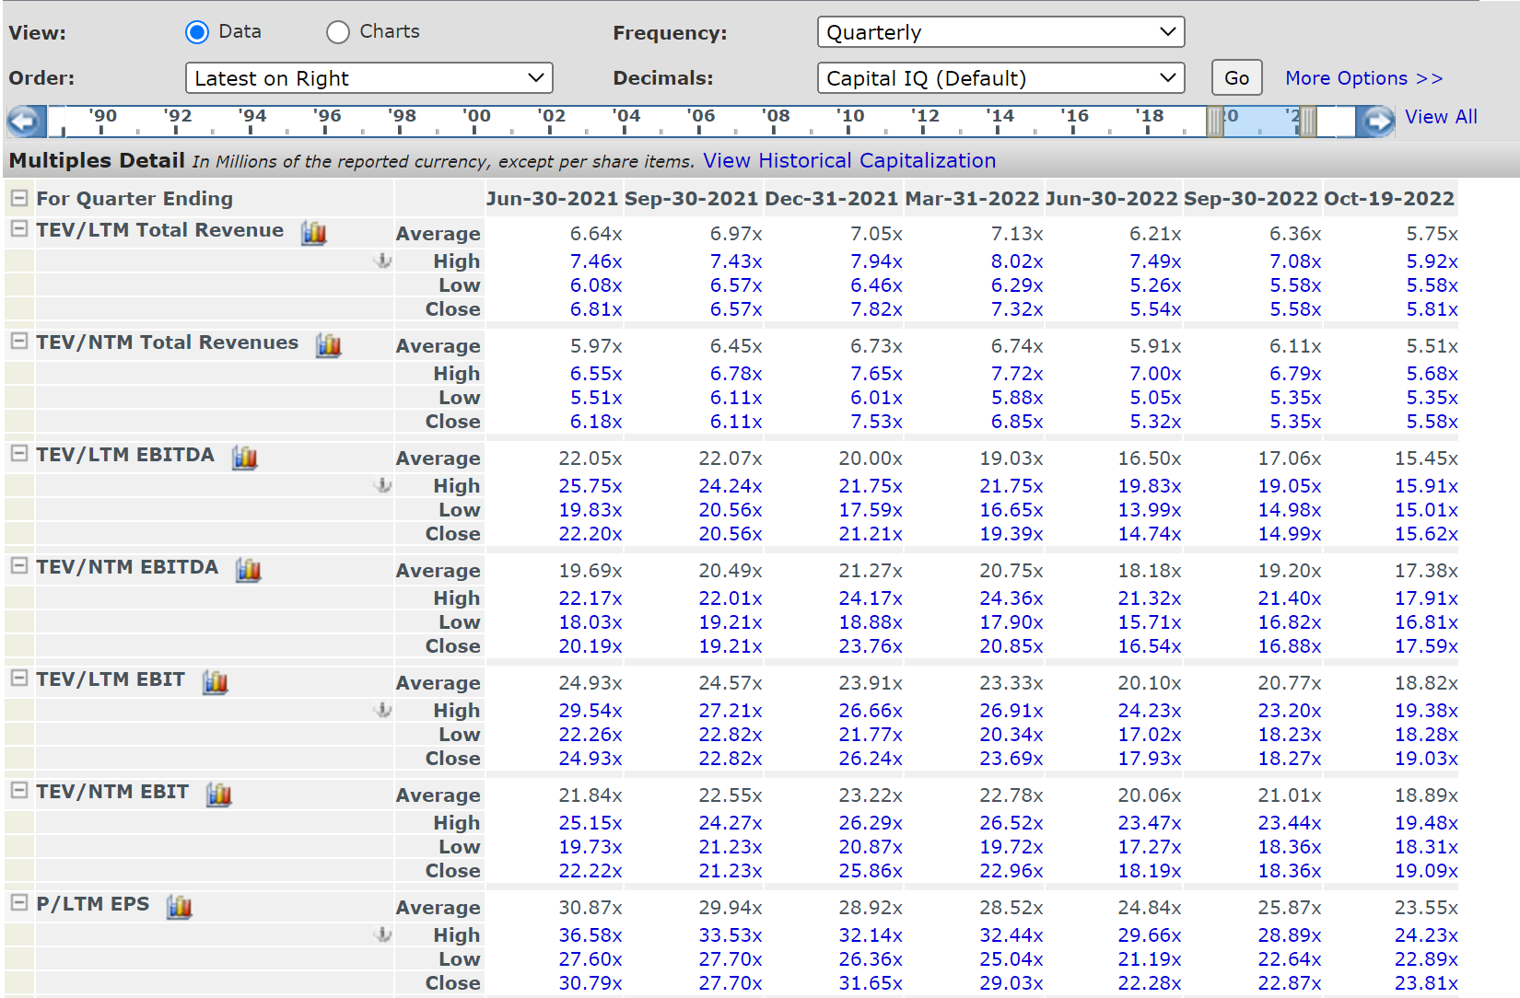
How to find earnings multiples (NOT PART OF TEMPLATE)
Toggle between quarterly, monthly, and annually
Cap IQ
Change the time period with slider

Slide 16
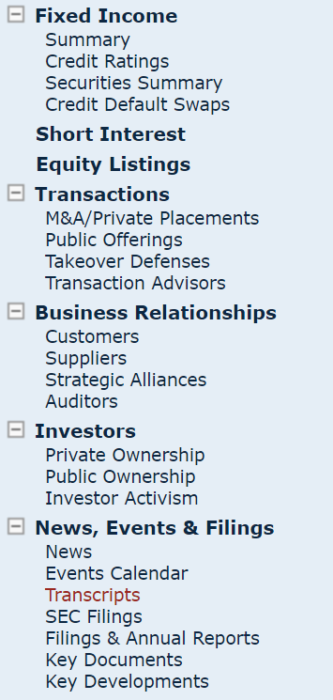
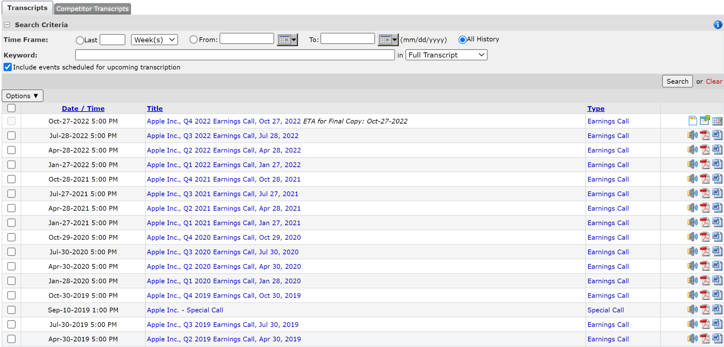
How to find earnings transcripts (NOT PART OF TEMPLATE)
Cap IQ

